Slide 1
Scoreboarding: Enforce Register Data Dependence
Scoreboard design, big example
MSCS23 ACA
Notes:
This lecture will cover sections 1.1-1.4: introduction, application, technology trends, cost and price.

Slide 2
Review - Pipelining
Pipelining Implementation
  All processors since 1985
  Overlap of instruction
  Improve performance
  Instruction Level Parallism
MSCS23 ACA

Slide 3
Review-Pipelining Issues
Hazards
  Data Hazards
  Structural Hazards
  Control Hazards
MSCS23 ACA

Slide 4
MIPS Operations-Multi cycle
Integer ALU Operations
Load store operations
Floating point operations (FP)
FP-Multiplications operations
FP-Division
MSCS23 ACA

Slide 5
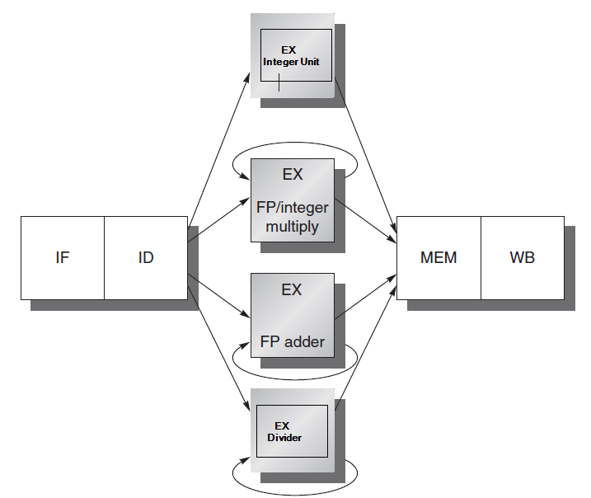
Extending MIPS Pipeline to Multi cycle operations
MSCS23 ACA

Slide 6
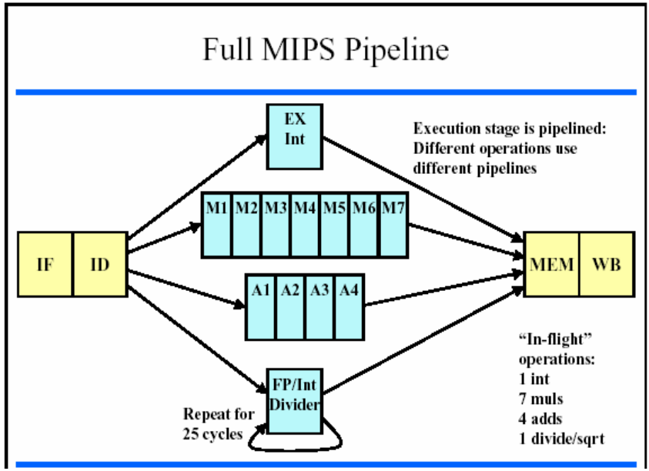
MSCS23 ACA

Slide 7
Pipelining Scheduling Techniques
Static Scheduling
  Compiler
  Software
Dynamic Scheduling
  Special Hardware
  Score boarding
MSCS23 ACA

Slide 8
Scoreboarding
CDC-6600
Dynamically scheduling pipeline
Out of order execution
Instructions are released only when the scoreboard determines that there are no conflicts with previously issued and incomplete instructions.
MSCS23 ACA

Slide 9
Scoreboarding- Stages
Issue
Read Operands
Execution
Write Results
MSCS23 ACA

Slide 10
From MIPS pipeline to Scoreboard
Out-of-order execution divides ID stage:
  1. Issue—decode instructions, check for structural hazards
  2.Read operands—wait until no data hazards, then read operands
CDC 6600: In order issue, out of order execution, out of order completion
MSCS23 ACA

Slide 11

Four Stages of Scoreboard Control
Issue—decode instructions & check for structural hazards
  Wait conditions: (1) the required FU is free; (2) no other instruction writes to the same register destination (to avoid WAW)
  Actions: (1) the instruction proceeds to the FU; (2) scoreboard updates its internal data structure
  If an instruction is stalled at this stage, no other instructions can proceed
Read operands—wait until no data hazards, then read operands
  Wait conditions: all source operands are available
  Actions: the function unit reads register operands and start execution the next cycle
MSCS23 ACA

Slide 12
Four Stages of Scoreboard Control
3. Execution—operate on operands (EX)
  Actions: The functional unit begins execution upon receiving operands. When the result is ready, it notifies the scoreboard that it has completed execution.
4. Write result—finish execution (WB)
  Wait condition: no other instruction/FU is going to read the register destination of the instruction
  Actions: Write the register and update the scoreboard
  WAR Example:
  DIVD F0,F2,F4
  ADDD F10,F0,F8
  SUBD F8,F8,F14
  CDC 6600 scoreboard would stall SUBD until ADDD reads operands
MSCS23 ACA

Slide 13
Scoreboard Connections
Registers
FP mult
…
FP mult
FP div
FP add
INT unit
Scoreboard
Control/
status
Control/
status
MSCS23 ACA

Slide 14
Three Parts of the Scoreboard
1. Instruction status—which of 4 steps the instruction is in
2. Functional unit status—Indicates the state of the functional unit (FU). 9 fields for each functional unit
Busy—Indicates whether the unit is busy or not
Op—Operation to perform in the unit (e.g., + or –)
Fi—Destination register
Fj, Fk—Source-register numbers
Qj, Qk—Functional units producing source registers Fj, Fk
Rj, Rk—Flags indicating when Fj, Fk are ready
3. Register result status—Indicates which functional unit will write each register, if one exists. Blank when no pending instructions will write that register
MSCS23 ACA
Notes:
What you might have thought
1. 4 stages of instruction executino
2.Status of FU: Normal things to keep track of (RAW & structura for busyl):
Fi from instruction format of the mahine (Fi is dest)
Add unit can Add or Sub
Rj, Rk - status of registers (Yes means ready)
Qj,Qk - If a no in Rj, Rk, means waiting for a FU to write result; Qj, Qk means wihch FU waiting for it
3.Status of register result (WAW &WAR)s:
which FU is going to write into registers
Scoreboard on 6600 = size of FU
6.7, 6.8, 6.9, 6.12, 6.13, 6.16, 6.17
FU latencies: Add 2, Mult 10, Div 40 clocks

Slide 15
Scoreboard Example
The following numbers are to illustrate behavior, not representative
LD – 1 cycle
  (compute address + data cache access)
ADDDs and SUBs are 2 cycles
Multiply is 10 cycles
Divide is 40 cycles
MSCS23 ACA

Slide 16
Detailed Scoreboard Pipeline Control
Instruction status
Wait until
Bookkeeping
Issue
Not busy (FU) and not result(D)
Busy(FU)← yes; Op(FU)← op;
Fi(FU)← `D’; Fj(FU)← `S1’;
Fk(FU)← `S2’; Qj← Result(‘S1’);
Qk← Result(`S2’); Rj← not Qj;
Rk← not Qk; Result(‘D’)← FU;
Read operands
Rj and Rk
Rj← No; Rk← No
Execution complete
Functional unit done
Write result
∀f((Fj( f )≠Fi(FU)
or Rj( f )=No) & (Fk( f ) ≠Fi(FU) or
Rk( f )=No))
∀f(if Qj(f)=FU then Rj(f)← Yes);
∀f(if Qk(f)=FU then Rk(f)← Yes); Result(Fi(FU))← 0; Busy(FU)← No
MSCS23 ACA
Notes:
1.Issue - if no structural haards AND non wAW (no Funtional Unit is going to write this destination register; 1 per clock cycle
2. Read -(RAW) if no instructions is going to write a source register of this instruction (alternatively, no write signal this clock cycle) +> gein exection of the instruction; many read ports, so can read many times
3. Execution Complete; multiple during clock cyle
4. Write result - (WAR) If no instructiion is watiing to read the destination register; assume multiple wriite ports; wait for clock cycle to write and tehn read the results; assume can oerlap issue & write
show clock cyclesneed 20 or so
Latency: minimum is 4 through 4 stages

Slide 17
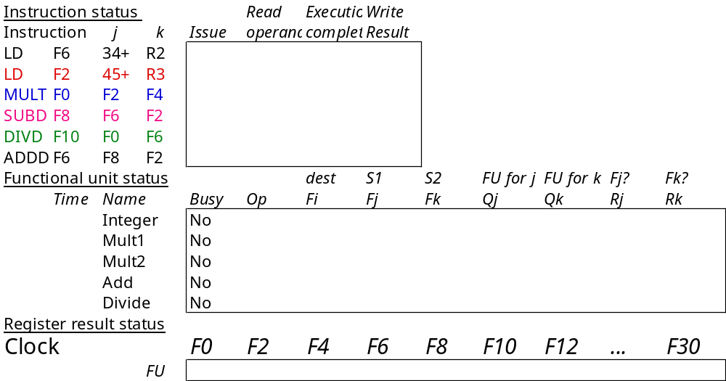
Scoreboard Example
MSCS23 ACA

Slide 18
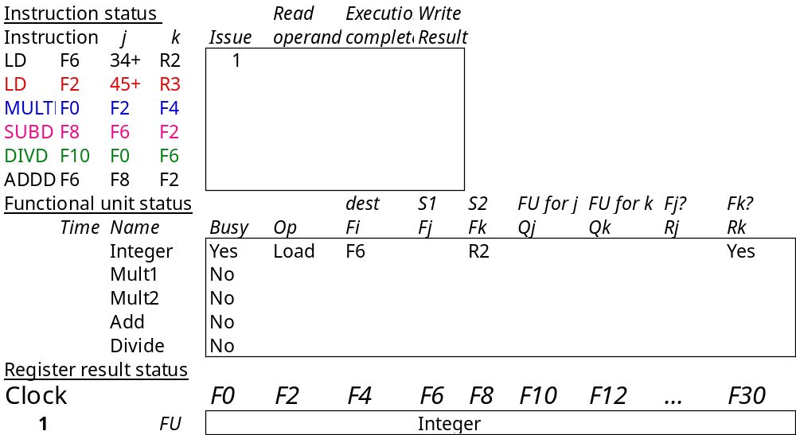
Scoreboard Example Cycle 1
MSCS23 ACA

Slide 19
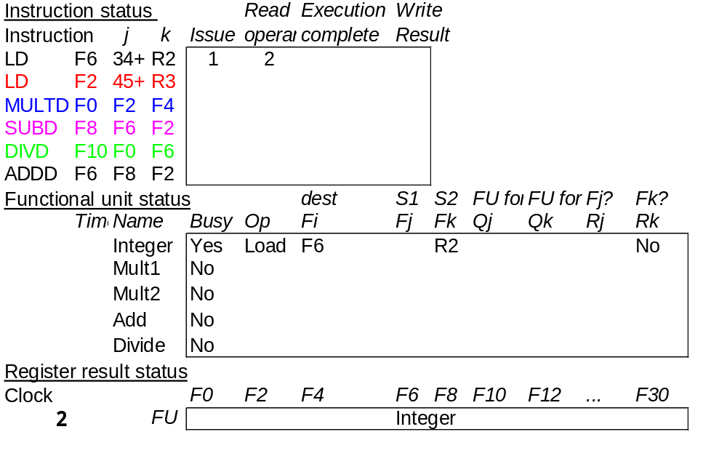
Scoreboard Example Cycle 2
Note: Can’t issue I2 because Integer unit is busy. Can’t issue next instruction due to in-order issue
MSCS23 ACA

Slide 20

Scoreboard Example Cycle 3
MSCS23 ACA

Slide 21
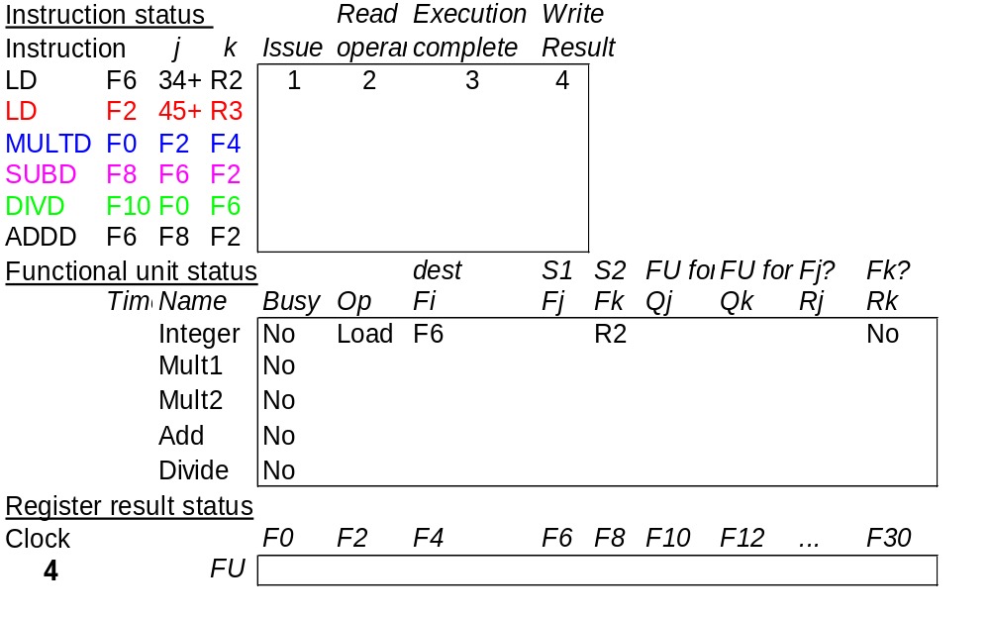
Scoreboard Example Cycle 4
MSCS23 ACA

Slide 22
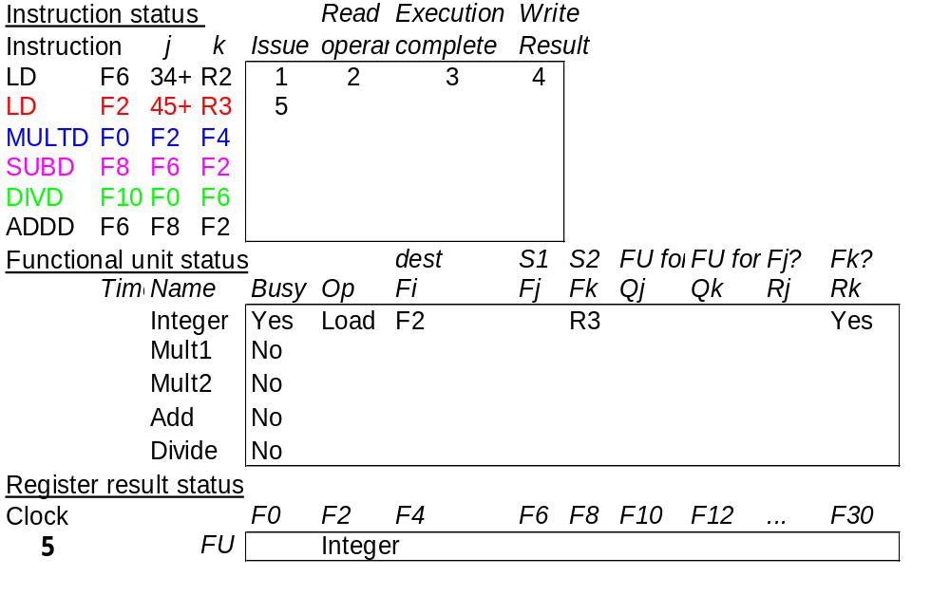
Scoreboard Example Cycle 5
Now I2 is issued
MSCS23 ACA

Slide 23
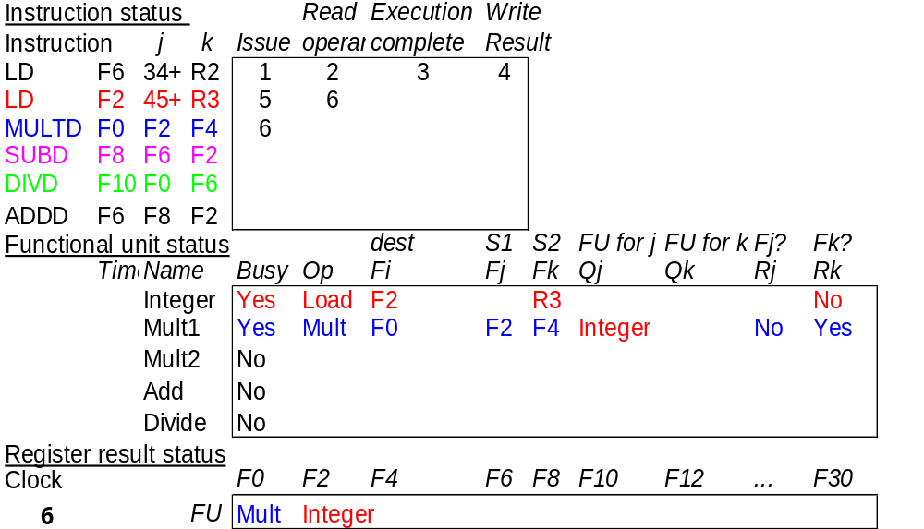
Scoreboard Example Cycle 6
MSCS23 ACA

Slide 24
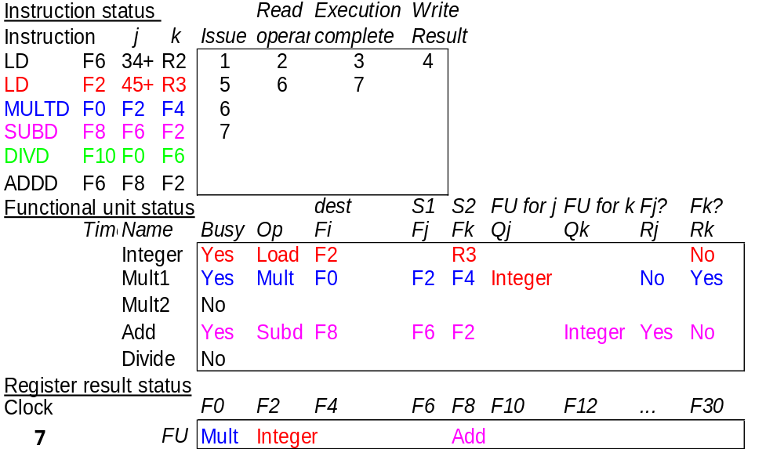
Scoreboard Example Cycle 7
I3 stalled at read because I2 isn’t complete
MSCS23 ACA

Slide 25
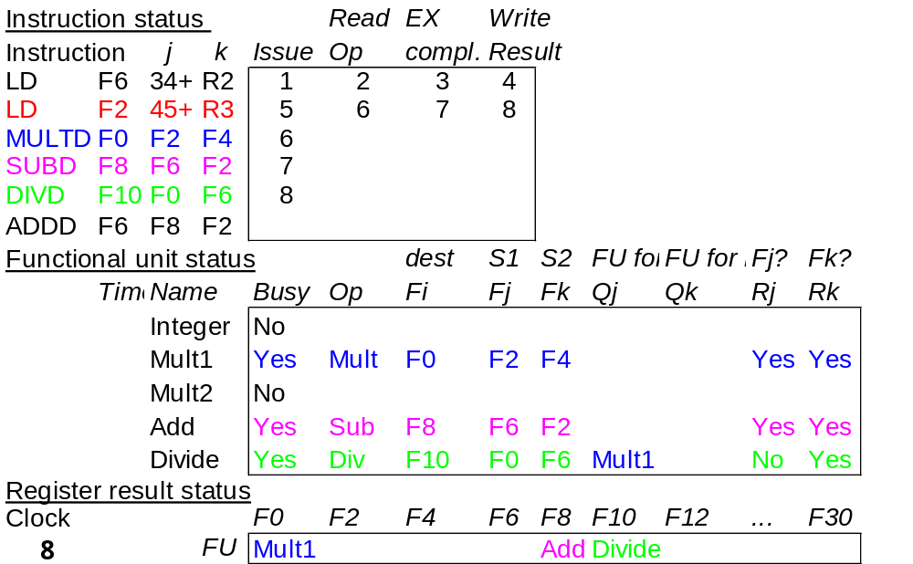
Scoreboard Example Cycle 8
MSCS23 ACA

Slide 26
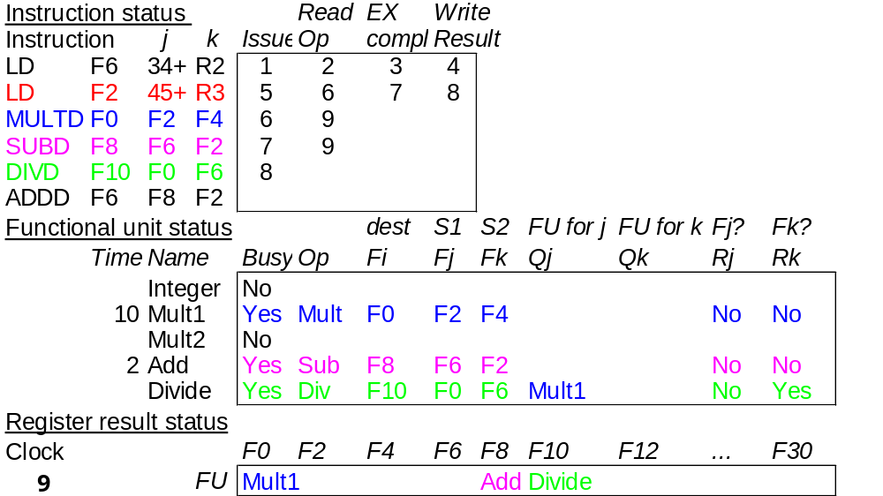
Scoreboard Example Cycle 9
Note: I3 and I4 read operands because F2 is now available. ADDD (I6) can’t be issued because SUBD (I4) uses the adder
MSCS23 ACA

Slide 27
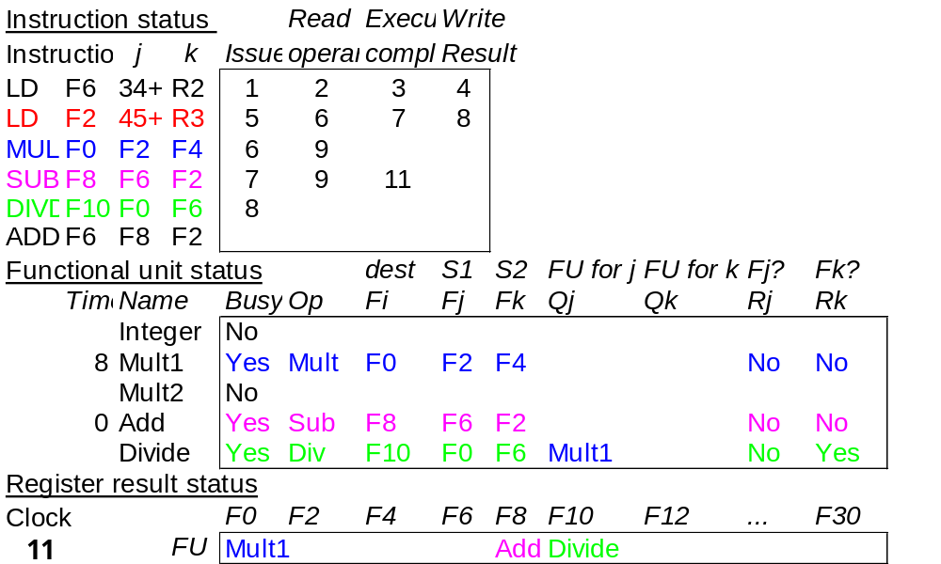
Scoreboard Example Cycle 11
Note: Add takes 2 cycles, so nothing happens in cycle 10. MUL continues.
MSCS23 ACA

Slide 28
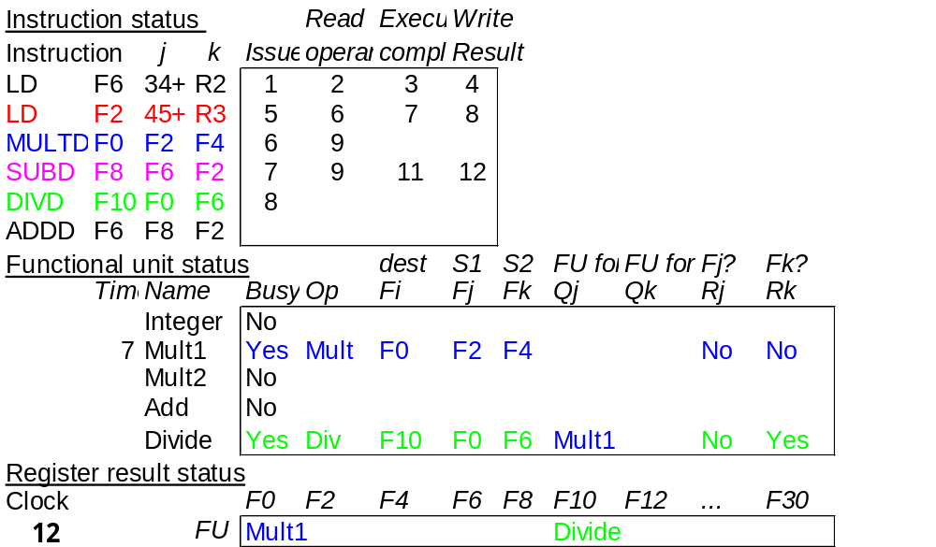
Scoreboard Example Cycle 12
MSCS23 ACA

Slide 29
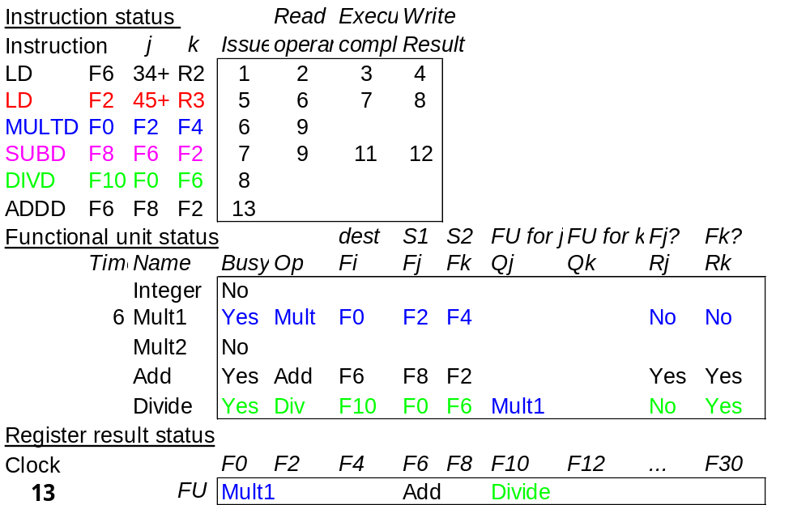
Scoreboard Example Cycle 13
Now ADDD is issued because SUBD has completed
MSCS23 ACA

Slide 30
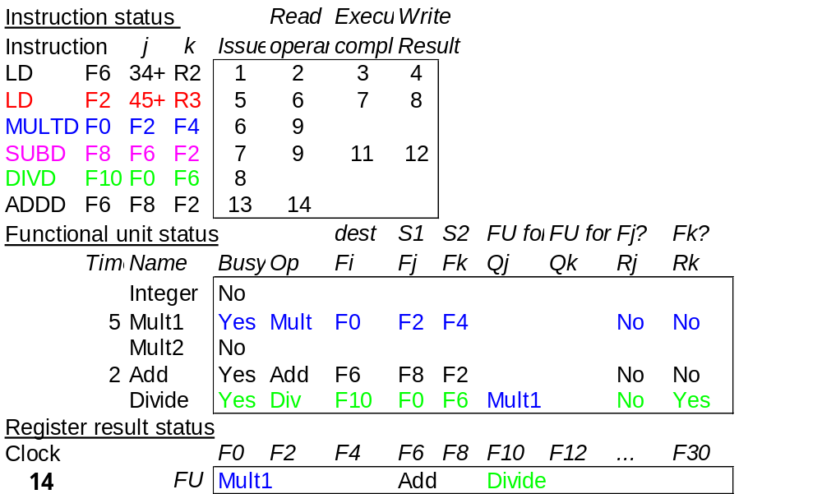
Scoreboard Example Cycle 14
MSCS23 ACA

Slide 31
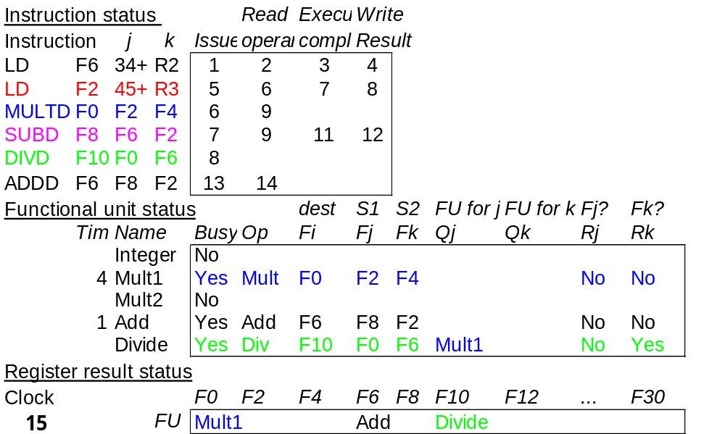
Scoreboard Example Cycle 15
Note: ADDD takes 2 cycles, so no change
MSCS23 ACA

Slide 32
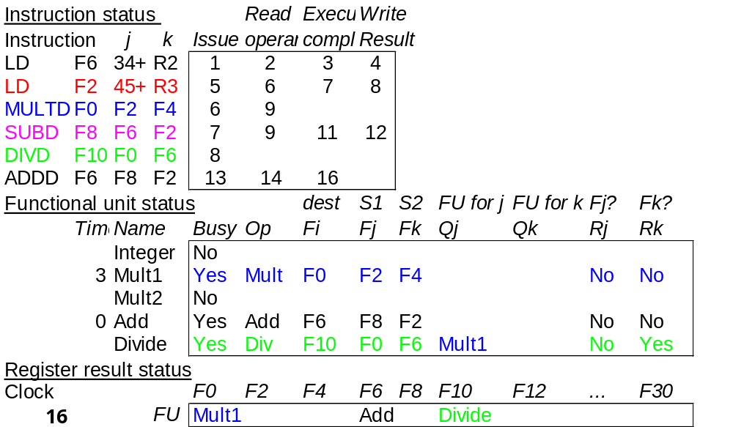
Scoreboard Example Cycle 16
ADDD completes, but MULTD and DIVD go on
MSCS23 ACA

Slide 33
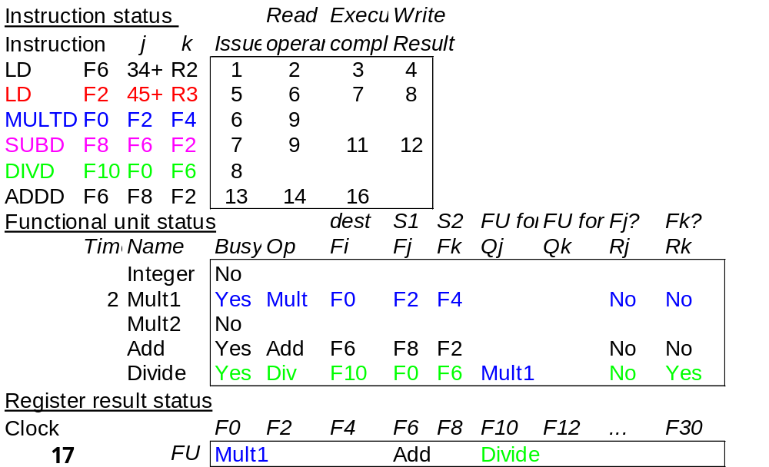
Scoreboard Example Cycle 17
ADDD stalls, can’t write back due to WAR with DIVD. MULT and DIV continue
MSCS23 ACA

Slide 34
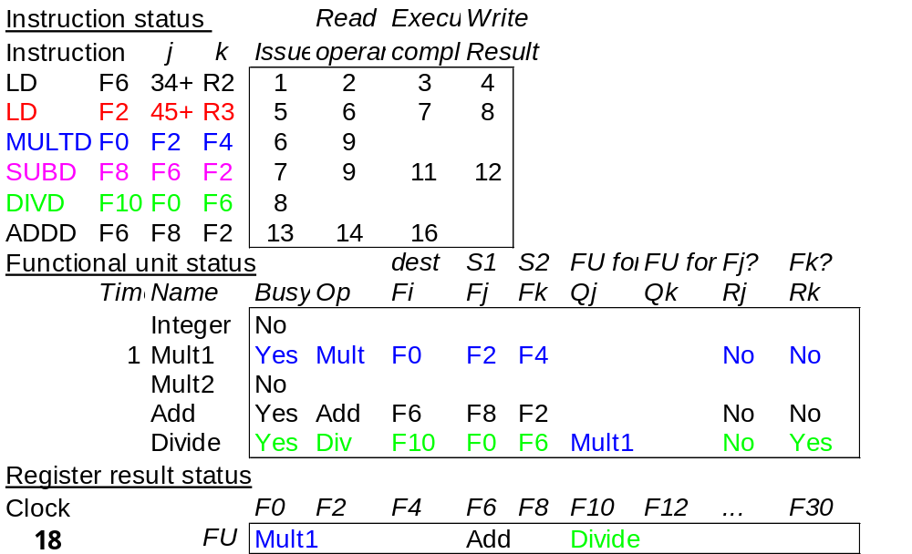
Scoreboard Example Cycle 18
MULT and DIV continue
MSCS23 ACA

Slide 35

Scoreboard Example Cycle 19
19
MULT completes after 10 cycles
MSCS23 ACA

Slide 36
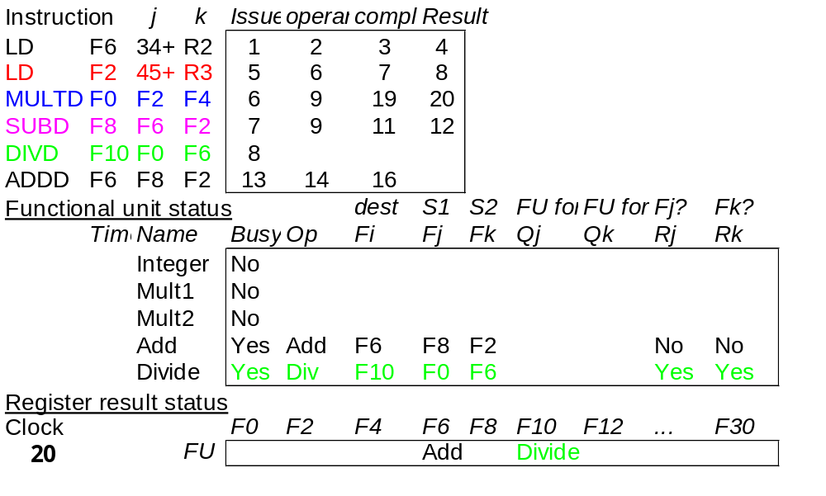
Scoreboard Example Cycle 20
MULTD completes and writes to F0
MSCS23 ACA

Slide 37
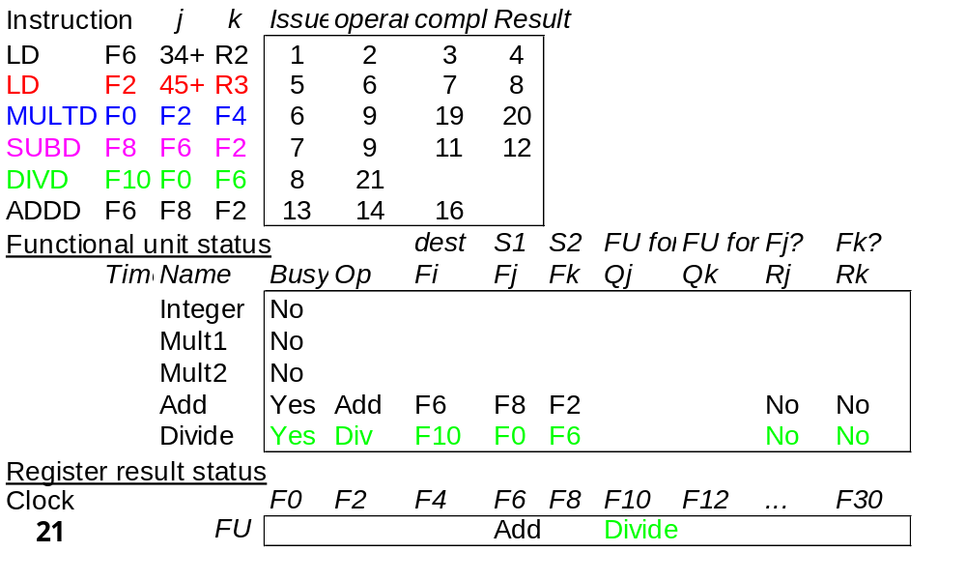
Scoreboard Example Cycle 21
Now DIVD reads because F0 is available
MSCS23 ACA

Slide 38
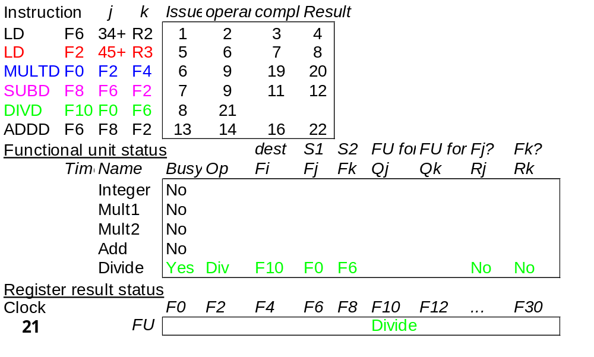
Scoreboard Example Cycle 22
ADDD writes result because WAR is removed.
MSCS23 ACA

Slide 39

Scoreboard Example Cycle 61
DIVD completes execution
MSCS23 ACA

Slide 40
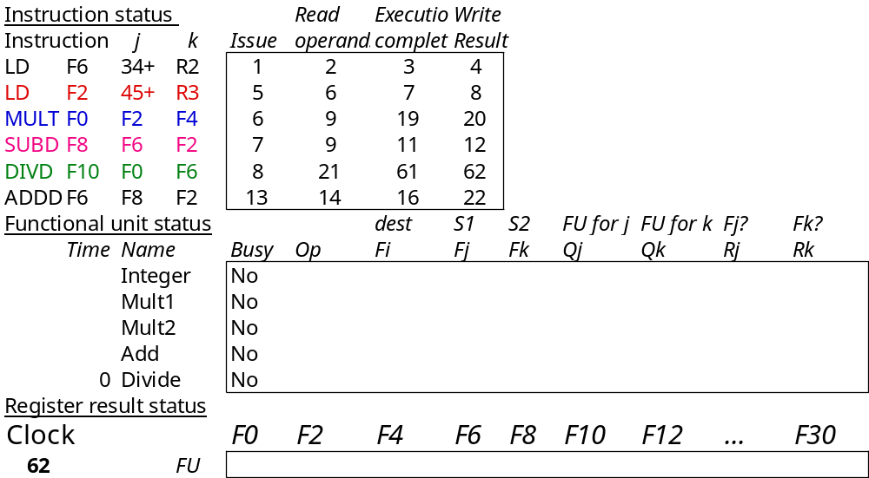
Scoreboard Example Cycle 62
Execution is finished
MSCS23 ACA

Slide 41
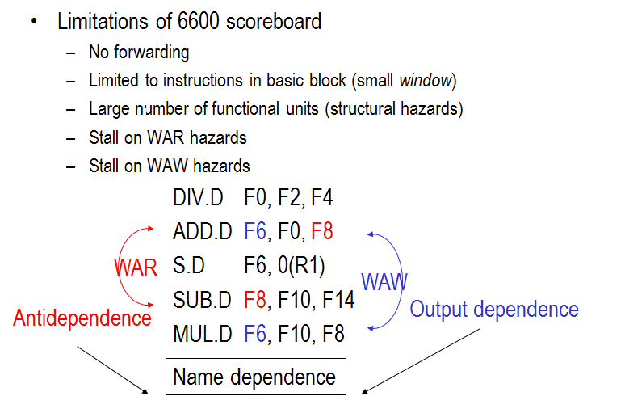
Review: Scoreboard
MSCS23 ACA

